Slide 1
How to Deploy Large-Scale Distributed Data Analytics and Machine Learning on Containers
Tom Phelan BlueData CTO / HPE Fellow
thomas.phelan@hpe.com, @tapbluedata

Slide 2
Agenda
Introduction to Analytics Platforms
Setting the Stage: What is the Problem?
How do Containers & Kubernetes Fit In?
What is the Gap Between Current and Desired State?
How Do You Get There?
Q & A

Slide 3
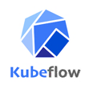

What a Journey…
2013
2019
Multi-Tenancy
Data Science
AI / ML
Data Management & Governance
Cloud Portability

Slide 4
What is the Problem?

Slide 5


Challenges with Traditional Big Data / AI / ML Systems
Time to provision new environments
Lack of analytical tool flexibility
Inefficient use of existing infrastructure – monolithic
Security management, access and compliance (e.g., GDPR, HIPAA, IRB)
Operationalizing use cases – can’t get to production
Cost and sustainability of current strategy
Notes:
So we see some common challenges that almost all enterprises face when it comes to managing big data analytics capabilities at scale. These transcend both Hadoop distributions, and use cases, and you could say are more endemic to the fundamental nature of the underlying technology.
The time to provision a traditional, on premise, Hadoop, bare metal, direct attached storage cluster can take anywhere from weeks to months. Although lead times on hardware procurement and installation are the major factor, other challenges are also significant. Data center capacity is an increasingly limiting factor. OS and application setup is generally streamlined but is rarely fully automated, and shows significant variation across use cases. And initial data loads are time and resource consuming,
Cluster underutilization is almost a hallmark of bare metal and DAS Hadoop cluster architectures. The most common scenario is filling disks while CPU is nearly idle, courtesy of the triple mirroring of HDFS data. This leads to the need to grow the cluster to add more storage, but as a consequence adding more CPU and making the underutilization problem worse. Occasionally memory is the constraint , with Spark jobs in particular, so that leads to different utilization issues. Industry metrics suggest average compute utilization is typically < 30%
Adding new use cases to existing clusters can be challenging, particularly with regard to balancing workloads and avoiding contention. It often requires the setup and tuning of multiple YARN queues, and can pose security and change management challenges. These are factors that typically drive demand for new, dedicated clusters and contribute to Hadoop sprawl.
Users expect toolset flexibility. Data scientists in particular keep a range of tools in their analytics toolbox. Whether it’s Spark, Python, R, or something else, they frequently evaluate new tools, versions, and code libraries, and want to use whatever is appropriate for the task at hand. This leads to frequent contention when a specific user or team wants to implement a new tool on a shared cluster, but other users aren’t ready to do so, or don’t want to risk breaking their environment. This is becomes even more challenging as analytics teams begin using deep learning techniques on GPU architectures. Frustrations with managing these inter-dependencies is another significant driver of dedicated team clusters, and another significant contributor to Hadoop sprawl.
With Hadoop sprawl come the challenges of managing multiple copies of data, servicing the needs of different analytics use cases. This is more than just a storage efficiency issue, particularly for data sets that might contain PII, PHI, or other sensitive transactional data. Management of access, auditing, and record retention in accordance with compliance and regulatory concerns are significant challenges. Management of access to limited data sets under HIPAA, research data sets under an IRB approval, or personal information under GDPR all fall into this category.
So the bigger picture here is that the cost and inflexibility of most big data deployment strategies is a limiting factor to success and adoption. Whether it’s the ongoing challenges of maintaining and supporting a large number of bare metal servers, implementing backup and DR as clusters increasingly become the driver of mission critical applications, or just trying to keep up with the latest and greatest technology versions while managing a stable operational platform, most companies with a large big data footprint are re-thinking their approach on how to deploy these capabilities.

Slide 6

What is an “Anti-Pattern”?
Notes:
The opposite of a best practice
Lessons-learned through real-world experience
The second mouse gets the cheese

Slide 7
Inelastic Architecture
Direct Attached Storage
Notes:
The most common anti-pattern that affects the scalability and cost of the big data deployment has to do with inelastic architecture. This pattern comes about by organizations slowly and organically growing their big data environment one server at a time, often buying cheaper servers initially, but eventually adding very expensive servers over time to keep up with the demands of the business. This is problematic on a couple of fronts:
Over time, the growth of data storage will far out-pace the growth of the compute needs.
Maintaining such a large, physical environment will become cumbersome and problematic.
Rather than buying very expensive servers with tons of storage, the best practice is to de-couple the compute and storage layers so that commodity servers can still be purchased, but the scale-out storage becomes much more efficient and affordable. Additionally, virtualizing the compute layer will allow for easier management, but more importantly, and elastic, cloud-like platform for the business.

Slide 8
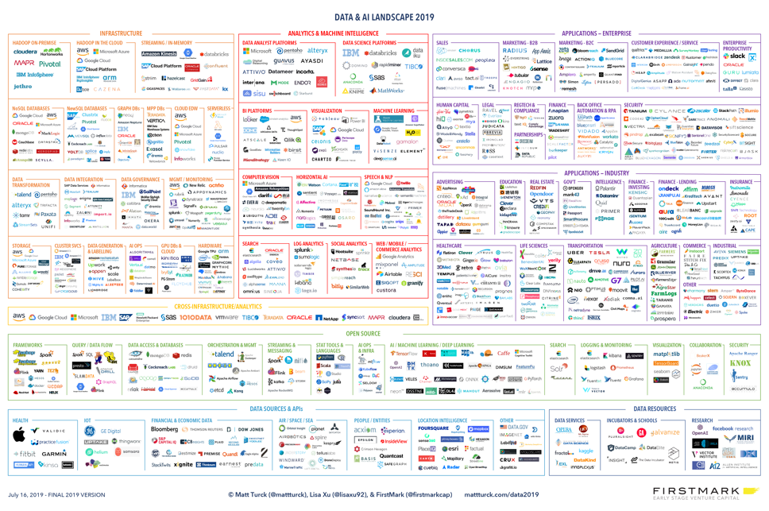
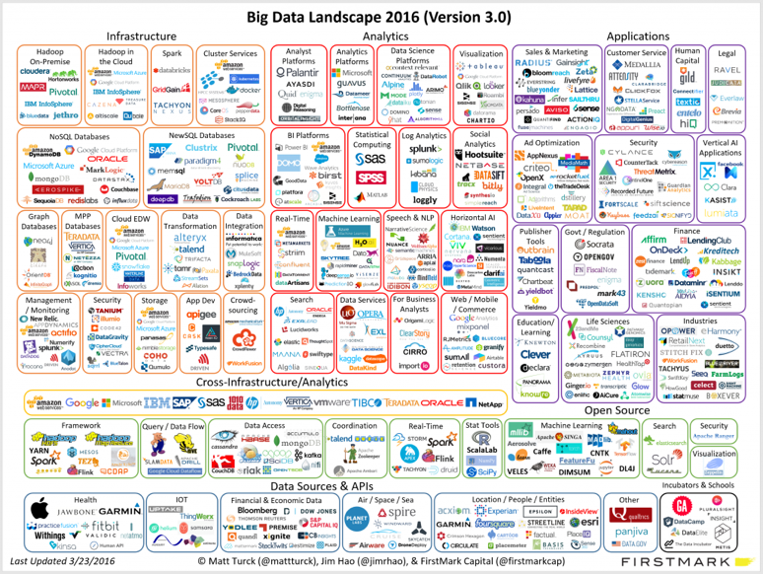
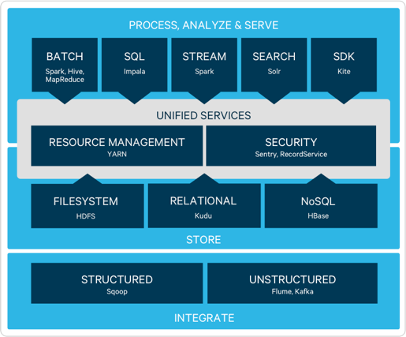
Replicating the Monolith
DATA SCIENCE TOOLS
MANAGEMENT
ETL
INGEST
MANAGE
GOVERN
Notes:
Deployments are still monolithic
Look to the cloud-native application space – doesn’t mean you need to develop micro-services for these components, but use that concept to break apart the monoliths to be more modular
Break down the workloads, treat them uniquely, deploy them intelligently
Long Running
Operational
Static
Re-startable
Ephemeral
Temporal

Slide 9
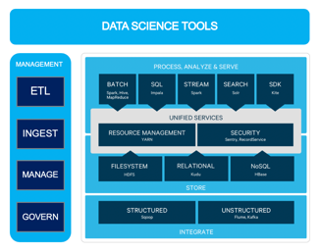
Replicating the Monolith
Notes:
Deployments are still monolithic
Look to the cloud-native application space – doesn’t mean you need to develop micro-services for these components, but use that concept to break apart the monoliths to be more modular
Break down the workloads, treat them uniquely, deploy them intelligently

Slide 10

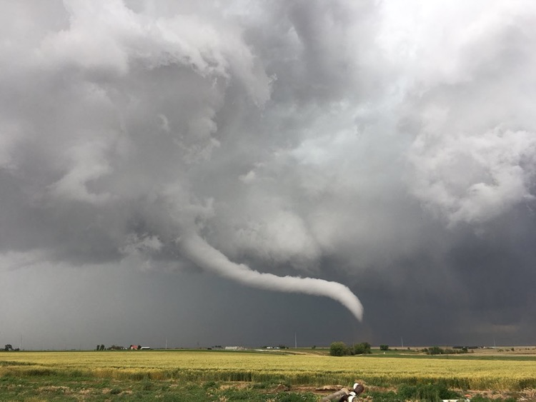
Rush to the Cloud
Notes:
Let’s talk about cloud for a moment. It is being viewed by many as the panacea that will solve all of the organizations IT problems. Tell me if you’ve heard any of these before:
Agility
Lower cost
Dynamic provisioning, on-demand, self-service
But the reality is that these are all possible, if the deployment is planned and well-thought-out, with the right governance and operating model in place.
Abandoning on-prem systems makes sense for some, but not all
Using the cloud in the same way you used on-prem is going to result in the same mess, in someone else’s environment, at a much higher cost
It requires a new operating model
Don’t tie yourselves to one cloud and abstract yourselves away from the infrastructure as much as possible. Portability is king.
Cloud is the new mainframe.

Slide 11





Data Scientist as Lone Explorer
Notes:
Picture, if you will – a community in the south pacific hundreds of years ago. Their island nation, once a flourishing community is starting to run out of natural resources. The council of elders has the foresight to deal with the problem before things become critical and decides to expand to other islands. Being isolated in the ocean though, there are none in the immediate vicinity, so they recruit volunteers – the strongest and fearless to explore into the unknown. These brave explorers head out with food and supplies. Some time later, some of them return, although some don’t.
Of those that return, a few have found land, although most of the land is either inhospitable or unworthy of settlement. However, one or two of those adventurers report that there are islands, many weeks away that are ripe for settlement. Lush vegetation, native foods, fresh water, and plenty of room to expand. The council has a decision to make though – how establish a settlement and begin relocating citizens?
Certainly the lone explorer accomplished an amazing feat by finding the island, but it will take different skill-sets to establish a new settlement there. Another question is how to get there? A fleet of single-person ocean canoes doesn’t seem to make sense. The community has the skills however, based on the development of the existing community and puts a team together to build new vessels better-suited for the journey and that leverages the skills of the community.
The journey of an organization into exploratory analytics and data science is similar in nature….

Slide 12


The Pattern
Data Scientists
Data Analysts
Data Engineers
Data Operations
SELF SERVICE REQUEST PORTAL
Tools
IDEs
Code/Models
Data
Metadata Repository
$
TEMPLATES & AUTOMATION
ENVIRONMENT
Multi-Tenancy
On-Prem
Public Cloud
DATA LAKE(S)
Read Only
Read/Write Sandbox
Notes:
So as I’ve said before, we’ve seen patterns and the problems that people are experiencing, and generally they’re same …… and what good looks like is a pattern that we can repeat.
So let’s jump in – who are the main personas trying to tackle these problems in the business? There are three that we’re going to focus on here:
*CLICK* Data Scientist
The first is the Data Scientist, they are tasked with change of the organization – these are the quant level people. They are trying to solve problems like “how do we increase sales? How do we prevent fraud” Very open-ended questions. They are typically the smallest piece of your analytics organization, but they are often the most vocal and demanding.
And if you ask these people – how much data do you need? Ten times out of ten they are going to tell you “all of it”. And if you ask them what tools do you need? They are going to say all of it and by the way, I also want to bring in all of my own tools. And while we’re at it, we also need infrastructure.
Data Scientists are going to do all of this in a very iterative and often times destructive way. And when I say destructive, it means writing python code, and often bad python code, and that’s going to crash clusters.
*CLICK* Data Analysts
The next persona are the Data Analysts and they are generally the most sizeable group within your analytic organization. These are the users that are using tools like SAS, Tableau, Qlikview, and Business Objects. The Data Analysts are really just closing the books, running the dashboards, creating reports about what happened and *monitoring the models that data scientists produce*.
So they are looking at “how much fraud did we prevent?” and “what rate did we increase sales?”. That’s very different than the data scientists who are predicting and looking forward, the Data Analysts are looking back and asking what happened.
But they both need access to the same systems and data. So what you don’t want is the data scientist crashing systems at month end close that the Data Analyst are dependent upon.
*CLICK* Data Engineers
The third persona is data engineers. These are your software engineers, people who know java, really good at SQL, using Ruby. They are taking the reports and models and operationalizing them and putting them out into production.
*CLICK* Data Ops
And lastly is Data Operations. This the team that owns the Hadoop clusters and owns the SAS environment. They keep the lights on and get the Dev/Test environment all set up. They have a very different challenge – when the data scientists come to them and say “I have a new project, I need a cluster, how long is it going to take for me to get this cluster? I need tools, I need data.” They often have to get that from operations.
*CLICK* Platform
So what do these personas want? They want a platform. They want to go to AWS, or Azure. They want to say you know what, I need tools.
*CLICK* Tools
I need R, I need Python.
*CLICK* IDE
I need a development environment to work on my algorithms
*CLICK* Models
Where’s my models? Give me a fraud model – give me version 1.1 and v 1.2 because I want to do a delta. Or a model that’s stale. Once you deploy a model, it decays over time and they constantly need to be brought back into development and retrained. Re-training models is not a good use of time for a highly paid Data Scientists, it’s a better use of time for the for a Data Analyst. It only works if they have a consistent starting point.
*CLICK* Data
Data – Perhaps most critical. Everyone needs data and lots of it. They need a dashboard of transaction information, customer call records, MRI images – they need a shopping cart experience to get access to all that data so that we can take it, along with the tools, the code, and the models, and BRING IT ALL TOGETHER in a development environment. Bringing this all together is NON-PRODUCTIVE time for Data Scientists, Data Analysts, and Data Engineers.
Provisioning infrastructure from scratch is non-productive time for your data operations team as well. So we need to automate that productivity, and then we’re asking a couple more questions:
*CLICK* Duration of environment
We’re going to ask – how long are you going to need that environment for? You know, this thing doesn’t sit around forever, you want a cloud-like experience – to spin up, spin down, rinse and repeat. It’s *really important* to elastically scale up and down.
*CLICK* What level of performance is required?
We also want to know what the performance characteristics of the environment are – so if I’m just selecting tools – for example Tensorflow FX, or Kafka because I’m building a queue, I don’t need all the memory, gpu’s and tons of storage. But if I’m training my model, I may need GPUs because I’m doing image recognition. So tell us what infrastructure you want to deploy.
You want to deploy the right workload, on the right infrastructure, at the right time and you need to know that so we don’t deploy the same monoliths every single time which is not cost sustainable.
*CLICK* Chargeback/showback
Last thing we’re going to ask – you know your project gets delivered - nothing comes for free. Even if you’re not doing to do pure chargeback, you should be able to show showback of how much infrastructure you used, at what time, what tools and licenses, and if you had to go acquire data. You need to be able to track that.
So that’s the interface that everyone wants to go to. This should not be a manually driven interface – this should all be metadata driven.
*Click* METADATA REPOSITORY
The metadata can be coming from a number of repositories of data speaking to this interface, as well as templates.
*CLICK* TEMPLATES AND AUTOMATION
And these templates are used to automate and orchestrate the deployment of what’s selected in the self-service portal. So *this is* automation, I have a typical business process – I check approvals, I deploy tools, infrastructure, data. We want to be able to slipstream into the existing CI/CD processes that you are already doing on the App side of the house, and we need to be able to do the same thing on the data side of the house.
What is this process doing?
*CLICK* ENVIRONMENT
This process is spinning up environments using modern technologies, and in this case, containers are being used.
*CLICK CONTAINERS*
And containers wrap these applications in a software-defined network, and multi-tenant environment.
So why Software-defined and multi-tenant? Well if you recall the data scientist who needs a R + Python + Spark environment, they are going to spin it up and we give them a couple of nodes, and they going to use that really bad code and you crash your system in a tenant – but that tenant is not going to affect the people in the other tenants.
*CLICK MULTITEnANCY*
And using containers that scenario you will be just fine – just spin it back up again. It takes a few minutes. You don’t have to go through the major heavy lifting of re-building that environment.
And because we are containerizing, let’s say we have a tenant called ETL. So you could have a nightly process, which every night it takes 4 hours – 2 AM to to 6 AM. Well at month end it runs from 2 AM to 9 AM – UNLESS, I can steal resources from other tenants. But I can only do this if I schedule this.
So now rather than having my ETL cluster which sits idle almost all of the month with this huge rack of infrastructure and software, I can steal those resources during the day and shuffle those them around. It’s exactly what’s happening in the public cloud, but we are also doing this on-prem.
*CLICK* ON-PREM and PUBLIC CLOUD
And lastly, since we are using containers, we can deploy these workloads in the public clouds as well.
So this sounds a lot like the app space, but what makes this interesting and different, and the real challenge, between using a tool like BlueData or rolling your own, is getting access to your data.
Most companies are using tools like chef, puppet, ansible, docker, which allows for sort of spinning up of these environments – which you know might take a couple of hours or couple of days, but the real challenge is getting access to the data which is the last mile.
*CLICK DATA LAKE(S)*
So connecting to that data, and following all of the same regulatory, internal standards of security, privacy, and read-only, that’s the hard part. That’s the lake here.
The lake is something that a lot of companies spent a lot of time and money building out, either with Cloudera or HortonWorks, and building it out as untouchable. They absolutely do not want to give data scientists direct access to this lake because they are destructive. But Data Analysts need access to this lake all of the time.
So what if logically, we talked about this data lake having two parts – you have your “Read Only or Golden Data” *CLICK*– and the only way to get data into this lake is by following standard processes. *CLICK* But if what if you were able to give access in that read-only way so that the data scientists select the data they want and get read-only access to that lake AND give them a write-able sandbox. *CLICK, CLICK*
This is our R/W space. Maybe they bring some data from the outside, and then they do their joins all in this writeable sandbox.
And what if you can tap into those 2 spaces – what would that mean? Well, this production lake meets all of your security and regulatory standards that your industry provides. You can have audit trail with traceability and governance around it.
IN SUMMARY
So, in summary, so this is what we have found good to look like
We’ve got all of the personas using the same interface to request what they want
It’s done in a repeatable fashion
It’s metadata driven
It’s Using templates to automate the creation of these environments, things that were done manually in the past
Connecting into the existing datalake(s)
Giving freedom to explore data, bring your own data, and bring your own tools.
That’s what good looks like. Any questions?

Slide 13
Containers and Kubernetes

Slide 14
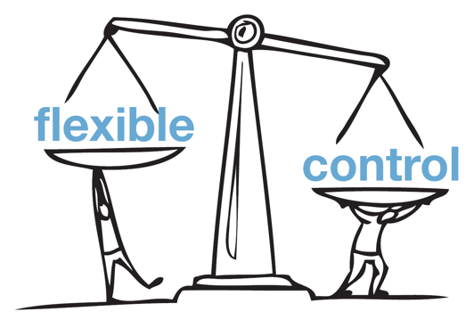
Requirements for Multiple Distributed Analytics Environments
Analysts / Data Scientists want Flexibility:
  Different sets of AI / ML tools and user interfaces
  Readily available scalable compute
IT / Operations wants Control:
  Multi-Tenancy
    Data security
    Network isolation
  Data Management
    Governance, Risk and Compliance

Slide 15
Why Containers?
Standardized environments
(dev, test, prod)
Applications/Workloads
Fool-proof packaging
Repeatable builds and orchestration (microservices, CI/CD)
Portability
(on-premises and cloud)
Efficient resource utilization
(bare metal or VMs)
Write once, run anywhere
Agility and elasticity
(fast provisioning, auto-scale)
Infrastructure
(configs, libraries, driver versions, models)

Slide 16
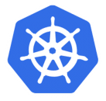
Future of Large-Scale Distributed Data Analytics and ML
Container
(image, code, resource unit)
Kafka 0.10
TensorFlow
+
Spark
Orchestration
(scheduling, config and automation)

Slide 17
Kubernetes (K8s)
Open source “platform” for container orchestration
Platform building blocks vs. turnkey platform
  https://kubernetes.io/docs/concepts/overview/what-is-kubernetes/#what-kubernetes-is-not
Top use case is stateless / microservices deployments
Evolving for stateful applications

Slide 18
Kubernetes (K8s) Usage for Large-Scale Distributed Environments
Use as a scheduler for analytics jobs
Run cloud-native / microservice apps
Running existing apps (monolithic) on containers
Not just managing pods (containers). Run end to end jobs
Kubernetes scheduler needs to be supported by app for jobs (e.g. Spark)
Auto-scaling
Examples:
Refactor/re-write applications as microservices (sweet spot!)
Deploy via Helm Charts/Operators
Manage storage using stateful sets
Leverage K8s ‘deployment’ capabilities – rolling upgrades
Examples:
Run apps (e.g. full Hadoop distribution, BI/ETL) unmodified
Use containers as lightweight VMs to host multiple services
Enhanced stateful sets that support container migration between hosts (incl. root file system)
Examples:
Spark on K8S
Confluent (Kafka) Operator
ElasticSearch Operator
Helm (possibly)
KubeDirector Project

Slide 19
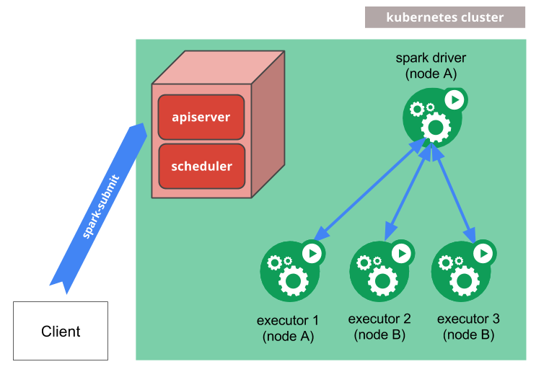
Spark on Kubernetes
Spark creates a Spark driver running within a Kubernetes pod
The driver creates executors pods dynamically and executes application code
When the application completes, executor pods are terminated (ala serverless type behavior)
Driver pod remains in “completed” state in the Kubernetes API (doesn’t use any compute/memory) – waits for next job
Source: https://spark.apache.org/docs/2.3.0/running-on-kubernetes.html

Slide 20
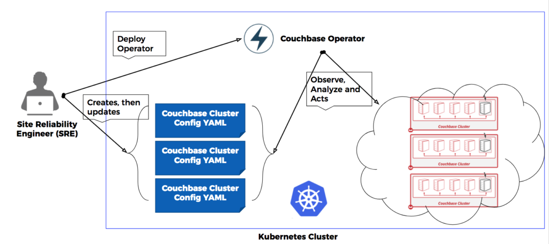

Application-Specific Operators (written for K8s)
Application-Specific Operator
(custom controller written in Go)
e.g. Spark, Kafka, Couchbase etc.
Deploy Cluster 1 Config YAML file
Cluster 1
Deploy Cluster 2 Config YAML file
Cluster 2
Deploy Cluster 3 Config YAML file
Cluster 3
Source: https://coreos.com/operators

Slide 21
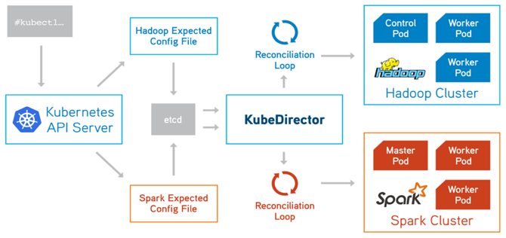
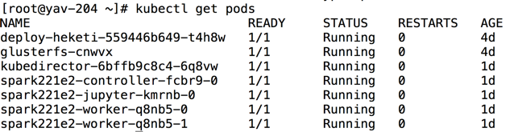
KubeDirector (bluek8s/kubedirector)
KubeDirector is a custom controller
  Eliminates the need to build app-specific operator
Watches for custom resources to appear / change
Creates / modifies standard Kubernetes resources (StatefulSets, etc.) in response to custom resources
  Reconciliation
https://github.com/bluek8s/kubedirector

Slide 22
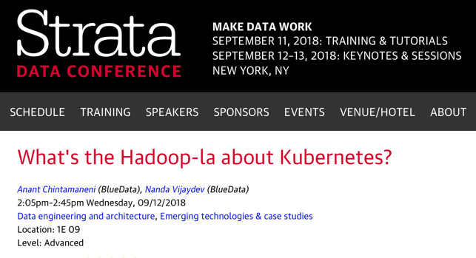
KubeDirector (bluek8s/kubedirector)
See session from Strata NY 2018
https://conferences.oreilly.com/strata/strata-ny-2018/public/schedule/detail/69534
https://github.com/bluek8s/kubedirector

Slide 23
Where is the Gap?
In the management of Analytics Platforms

Slide 24













Status Quo
MARKETING
R&D
MANUFACTURING
Waiting for Environments
360 Customer View
Log Analysis
Predictive Maintenance
Complexity and
Inefficiency
Inconsistency, lack
of data governance
High cost, with limited
agility and flexibility
De-centralized
operating model
2.4
2.5
2.6
(BI Node Prod)
(M/L Node)
Cluster Sprawl
< 30%
Utilization
Prod
Dev
Pre-Prod
LOCAL ADMINS
IT
LOCAL ADMINS
2.6
BI Node Test
Dev
2.5
Test
Management Complexity
Duplication
of Data

Slide 25






Desired Future State
Secure, Optimized, Multi-Tenant Hybrid Architecture with Cloud Bursting
MARKETING
R&D
MANUFACTURING
360 Customer View
Log Analysis
Predictive Maintenance
Simplicity and
efficiency
Cost-effective, with
agility and flexibility
Integrated data layer
with governance
Centralized
operating model
Compute Isolation
Compute Isolation
Existing, Non-K8s Apps
K8s Operators
K8s Ephemeral Jobs
Prod
UAT
Prod
Prod
UAT
Elastic Control Plane
Data Management & Governance
Data Isolation
Data Isolation
MARKETING
R&D
MANUFACTURING

Slide 26
Desired Future State => Next Gen Hybrid/Multi-Cloud
On-Prem
Cloud
Containerized Service
(e.g Spark)
Compute
Containerized Service
(e.g Spark)
Elastic Containerized Service N
(e.g Spark)
Elastic Containerized Service N
(e.g. Spark)
Burst or Move ➔
On-Prem K8s
Cloud K8s
(GKE, EKS, AKS
Data
Cloud
Storage
(S3, GCS, Blob)
On-Prem Storage
(Object)
In-Place Access / Replicate / Mirror ➔
On-Prem Storage
(Object)
with security policies

Slide 27
How Do You Get There?
Container / Kubernetes platform that enables deployment of non cloud-native and microservices applications

Slide 28





Turnkey Container-Based Platform for Analytics / AI / ML
Data Scientists
Developers
Data Engineers
Data Analysts
HPE/BlueData EPIC Platform
Big Data Tools
ML / DL Tools
Data Science Tools
BI / Analytics Tools
Bring Your Own
ElasticPlane – Self-service, multi-tenant clusters
IOBoost – Extreme performance and scalability
DataTap – In-place access to data on-prem or in the cloud
* EPIC = Elastic Private Instant Clusters
Compute
CPU’s
GPU’s
Storage
NFS
HDFS
On-Premises
Public Cloud
Notes:
A double click into the BlueData EPIC architecture.
As mentioned earlier BlueData EPIC software is a turnkey container based platform. What we mean by turnkey is that the BlueData EPIC software platform can be deployed on a set of servers that can be mixed generation can be compute intensive and/or storage intensive, be loaded with CPU’s or GPU’s but when deployed across the various servers provides some key capabilities.
First and foremost it provides the ElasticPlane capability which is a management user interface that is backed by RESTful API’s which enables and organization to pool all the resources, the CPU’s the GPU’s, the storage on servers that EPIC is installed on and allows an administrator to apportion resources to different user groups, to different lines of business, however it makes sense for that particular enterprise so that those groups can create one click clusters or environments for big data process, advanced analytics for Machine Learning, Deep Learning or exploratory data science
All of these products are deployed as containers so that the resources can be used in the most efficient manner you can achieve elasticity and automation by deploying these environments using containers. Again BlueData is turnkey because it takes care of all of the networking, storage and policies with respect to containers and hides the administrative complexity or the detailed operational issues that organizations might face if they cobble these tools together.
Another key value proposition of BlueData is the DataTap technology. When you spin up environments in containers whether they are for Machine Learning or for big data you don’t want to copy hundreds of terabytes or even petabytes of data into the containers. That would defeat the purpose of having an elastic environment that can be expanded, shrunk, reassigned and so on. The whole purpose is to ensure the compute environments are elastic and dynamic but have the ability to access the data that is stored in your existing secure hdfs data lakes, nfs file systems, so that users can perform in place analytics against that data. So DataTap is a connectivity layer that is high performant to connect your compute environment, whether Machine Learning, Deep Learning or Big Data Analytics to your existing storage systems so you can do in place analytics.
IOboost is a capability that works hand in hand with DataTap to ensure you get the maximum performance. BlueData deployments can also be expanded into the cloud whereby cloud instances can be added to the EPIC deployment to get additional compute and storage capacity, especially when you don’t have infrastructure immediately available. So with the BlueData architecture you are able to provide a hybrid cloud environment where you can have a set of servers spread out across your different data centres as well as cloud instances that could be in one or more clouds provided there is network connectivity for your different virtual private cloud zones with your data centre.

Slide 29






Add K8s workloads (Operators) as they are made available by ISVs
Data Scientists
Data Analysts
DevOps
Sys Admins
HPE/BlueData EPIC Platform
Bring Your Own / More
BlueData ElasticPlane – Self-service, multi-tenant containerized applications & services
Kubernetes orchestration engine
BlueData DataTap
In-place access to data on-prem or in the cloud
MapR-XD Data Fabric
Multi-protocol, high performance data services for persistent storage
Compute
CPU’s
GPU’s
Storage
External NFS
External HDFS
HPE Cloud Volumes
On-Premises
Public Cloud
Notes:
A double click into the BlueData EPIC architecture.
As mentioned earlier BlueData EPIC software is a turnkey container based platform. What we mean by turnkey is that the BlueData EPIC software platform can be deployed on a set of servers that can be mixed generation can be compute intensive and/or storage intensive, be loaded with CPU’s or GPU’s but when deployed across the various servers provides some key capabilities.
First and foremost it provides the ElasticPlane capability which is a management user interface that is backed by RESTful API’s which enables and organization to pool all the resources, the CPU’s the GPU’s, the storage on servers that EPIC is installed on and allows an administrator to apportion resources to different user groups, to different lines of business, however it makes sense for that particular enterprise so that those groups can create one click clusters or environments for big data process, advanced analytics for Machine Learning, Deep Learning or exploratory data science
All of these products are deployed as containers so that the resources can be used in the most efficient manner you can achieve elasticity and automation by deploying these environments using containers. Again BlueData is turnkey because it takes care of all of the networking, storage and policies with respect to containers and hides the administrative complexity or the detailed operational issues that organizations might face if they cobble these tools together.
Another key value proposition of BlueData is the DataTap technology. When you spin up environments in containers whether they are for Machine Learning or for big data you don’t want to copy hundreds of terabytes or even petabytes of data into the containers. That would defeat the purpose of having an elastic environment that can be expanded, shrunk, reassigned and so on. The whole purpose is to ensure the compute environments are elastic and dynamic but have the ability to access the data that is stored in your existing secure hdfs data lakes, nfs file systems, so that users can perform in place analytics against that data. So DataTap is a connectivity layer that is high performant to connect your compute environment, whether Machine Learning, Deep Learning or Big Data Analytics to your existing storage systems so you can do in place analytics.
IOboost is a capability that works hand in hand with DataTap to ensure you get the maximum performance. BlueData deployments can also be expanded into the cloud whereby cloud instances can be added to the EPIC deployment to get additional compute and storage capacity, especially when you don’t have infrastructure immediately available. So with the BlueData architecture you are able to provide a hybrid cloud environment where you can have a set of servers spread out across your different data centres as well as cloud instances that could be in one or more clouds provided there is network connectivity for your different virtual private cloud zones with your data centre.

Slide 30
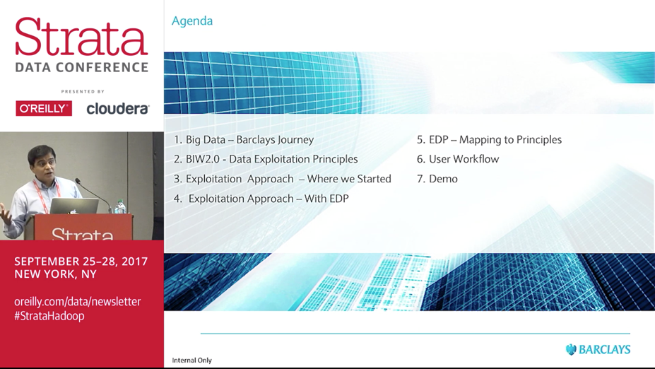
In Customer Use Today
https://conferences.oreilly.com/strata/strata-ny-2017/public/schedule/detail/63255
Notes:
Bala chandrasekaran

Slide 31
Key Takeaways
Large-scale distributed data analytics and machine learning need new architectures
Requires new principles (e.g. isolated environments, elasticity, data management)
Containers and Kubernetes are essential for a new cloud-ready, agile architecture
Solution must deploy ‘existing’ (non cloud native) apps and ‘newly’ minted K8s apps
HPE’s BlueData is a certified container software platform to deploy existing CDH/HDP distributions and AI / ML with path to deploy planned K8s services like Hive, Impala etc.

Slide 32
Any Questions?

